Slide 1


A swarm of robots for encouraging desired social behaviors
Serge Saaybi
Thesis Status update report
TU Delft | 17 May 2021

Slide 2
Table of content
11 May --> 18 May
Overall benchmark strategy and choices
Identify and review the different algorithms required for our project:
Review DRL navigation papers
Review image recognition/ breach detection papers
Assess and compare the identified literature
What are the most adequate algorithms for our task
Work on implementing a DRL algorithm (other than DQN) in simulation

Slide 3



Overall benchmark strategy and choices
Hardware selection
Jetson nano
When deploying AI applications, specific hardware requirements are needed for inference. The hardware would need to provide real-time performance, sufficient memory, cost efficiency, state of art architecture and low power requirements
Jetson Xavier NX
Simulation selection
Selecting the right environment to simulate the required task is necessary especially to lower the sim2real gap:
We need to simulate for training the DRL algorithm. Once we get a decent model, we move it to the hardware
ROS
Gazebo simulator
Software selection
Vision algorithm
Navigation algorithm
Swarm algorithm
There are three main algorithms to be deployed for this application, namely: breach detection for Covid-19 social distancing monitoring, robotic navigation in a mapless environment while avoiding obstacles (dynamic and static ones), and finally an algorithm for dividing tasks between a swarm of robots.
Deep learning algorithm leveraging human pose estimation
Vision-based Navigation Using Deep Reinforcement Learning
WIP

Slide 4
Robot navigation
Identified literature
Paper | Summary/ Sensors | Algorithm
Mobile Robot Navigation based on Deep Reinforcement Learning | DRL for the navigation of mobile robots in an unknown environment Uses RGB-D camera: uses depth image information | Dueling architecture based double deep q network (D3QN)
Deep Reinforcement learning for real autonomous mobile robot navigation in indoor environments | Mapless robotics navigation Sensor fusion of a laser scanner (wide opening angle) and RGB-D camera (3D perception) | Asynchronous Advantage Actor-Critic network (GA3C)
Target-driven Visual Navigation in Indoor Scenes using Deep Reinforcement Learning | Navigating a space to find a given target using only visual input RGB camera | Variant of A3C
Vision-based Navigation Using Deep Reinforcement Learning | Navigating a mobile robot, to a target given by an image | Variant of the Batched A2C algorithm
Visual Navigation in Real-World Indoor Environments Using End-to-End Deep Reinforcement Learning | DRL visual navigation in the real world Tried it in both simulation and reality | Parallel Advantage Actor- Critic (PAAC) algorithm
Towards Generalization in Target-Driven Visual Navigation by Using Deep Reinforcement Learning | Generalizes DRL vision navigation It is not tested in a real environment | IMPALA
COVID-Robot: Monitoring Social Distancing Constraints in Crowded Scenarios | Uses a mobile robot with a 2-D lidar to perform collision-free navigation | PPO
Autonomous Social Distancing in Urban Environments using a Quadruped Robot | Uses a 3D LiDAR on a legged robot | PPO

Slide 5
Identifying social distancing violations (1/2)
Identified literature
Paper | Summary | Algorithm
COVID-19: AI-Enabled social distancing Detector Using CNN | Uses the Jetson nano to run the social distancing application Alerts groups breaching social distancing | Human detection in live video stream using YOLO Computing pairwise distance between 2 individuals
Monitoring COVID-19 social distancing with person detection and tracking via fine-tuned YOLO v3 and Deepsort techniques | Deep learning based framework for automating the task of monitoring social distancing using surveillance video | YOLO v3 object detection Deepsort approach to track people
A Vision-based Social Distancing and Critical Density Detection System for COVID-19 | Uses monocular camera and DL to detect individuals in a region of interest (ROI) and measure the interpersonal distances Discusses critical aspects to be considered (security, ethics, etc.) | Faster R-CNN and YOLOv4
A deep learning-based social distance monitoring framework for COVID-19 | Uses transfer learning Identify humans in video sequences, and uses the Euclidian distance to evaluate breaches | YOLOv3 object recognition
Social distancing tracker using YOLO v5 | Determining social distancing utilizing YOLO object discovery on video film and pictures continuously Uses the Euclidian distance | YOLO v5
DeepSOCIAL: Social Distancing Monitoring and Infection Risk Assessment in COVID-19 Pandemic | Three-stage model including people detection, tracking, inter-distance estimation | YOLO

Slide 6
Identifying social distancing violations (2/2)
Identified literature
Paper | Summary | Algorithm
Automatic Social Distance Estimation From Images: Performance Evaluation, Test Benchmark, and Algorithm | Estimate social distances taking advantage of object detection and human pose estimation | OpenPose YOLO v4
Perceiving Humans: from Monocular 3D Localization to Social Distancing | Detect humans in 3D given a single image Recognize social interactions and monitor social distancing | PifPaf pose detector Monoloco++ F-formation estimation
COVID-Robot: Monitoring Social Distancing Constraints in Crowded Scenarios | Uses a mobile robot with a 2-D lidar | YOLO v3
Autonomous Social Distancing in Urban Environments using a Quadruped Robot | Uses a 3D LiDAR on a legged robot | YOLO

Slide 7
Navigation (1/2)
From traditional methods to DRL
SLAM is one of the more traditional methods for robot navigation. It uses a high precision laser or camera to build an obstacle map of the environment. This method has several disadvantages such as:
Time consuming for building the map and updating it
High reliance on accurate dense laser sensors for mapping
Operates mainly in simple and static environments and hard to learn and generalize properly to new unseen scenarios
Considering these challenges, mapless navigation has been proposed as of late. This is where DRL comes in. Combined with CNN, DRL manages the relationship between sensing (vision, lidar) and motion.
In our case, since we are already using a camera for vision, and as we are to optimize on the overall cost, vision-based methods seemed interesting especially with the availability of lower cost cameras.
Visual navigation consists of having an agent (mobile robot) navigate in an environment using camera input only. The agent is given a target image and its goal is to move from its current position to the target by applying a sequence of actions, based on the camera observations only.

Slide 8
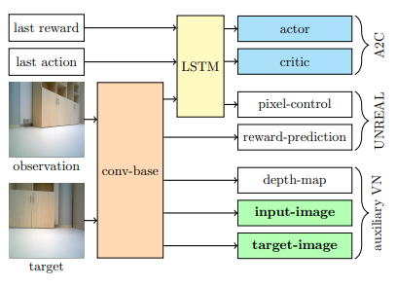
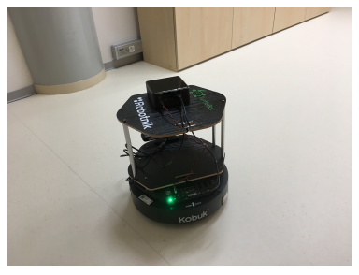
Navigation (2/2)
Visual Navigation in Real-World Indoor Environments Using End-to-End Deep Reinforcement Learning
This architecture uses a single deep neural network as the learning agent. It outputs a probability distribution over a discrete set of allowed actions. The input to the agent is the visual output of the camera mounted on the robot, and an image of the goal. The network is trained using the Parallel Advantage ActorCritic (PAAC) algorithm.
After the training, the agent uses its trained policy and requires only the camera observation and the target image – no depth image or localization is necessary:
First, the agent is pre-trained in a simulated environment using the simulator.
RGB-D images are then collected from the real-world environment, and the agent is fine-tuned on this dataset.
Finally, the agent can be placed in a real-world environment with an RGB camera as its only sensor.
Training took ~30 hours on a single GPU. In 30 navigation experiments, the robot reached a 0.3-meter neighborhood of the goal in more than 86.7% of cases
Mobile robot TurtleBot 2 in the experimental environment

Slide 9
Image recognition and breach detection (1/2)
From traditional methods to more precise ones
Most of the methods identified rely on the bounding boxes drawn by object detectors to detect social distance violations.
Although the current object detection algorithms such as YOLO or R-CNN are accurate in detecting objects, the bounding boxes are generally loosely drawn around these objects. Thus, it is not reliable to use only the bounding box information for estimating exact distances between people as it is not possible to infer accurate 3D location estimates from the bounding boxes alone.
Therefore, a solution is to estimate exact 3D locations of all the people in RGB images with respect to the camera by using the information extracted from the human body skeleton detected by body estimation algorithms.

Slide 10
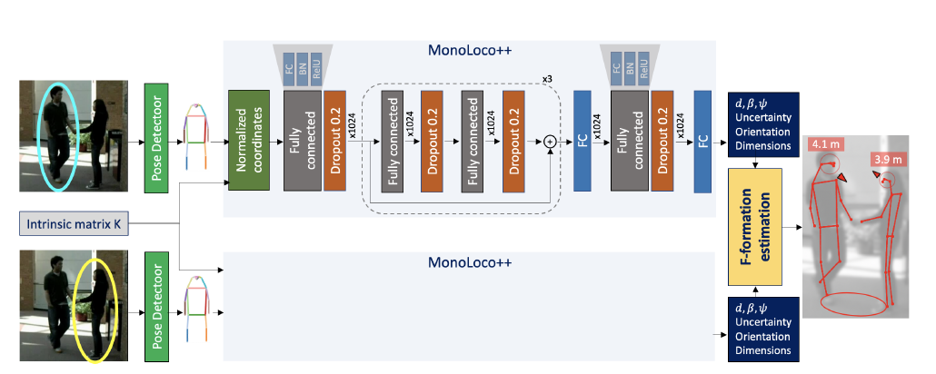
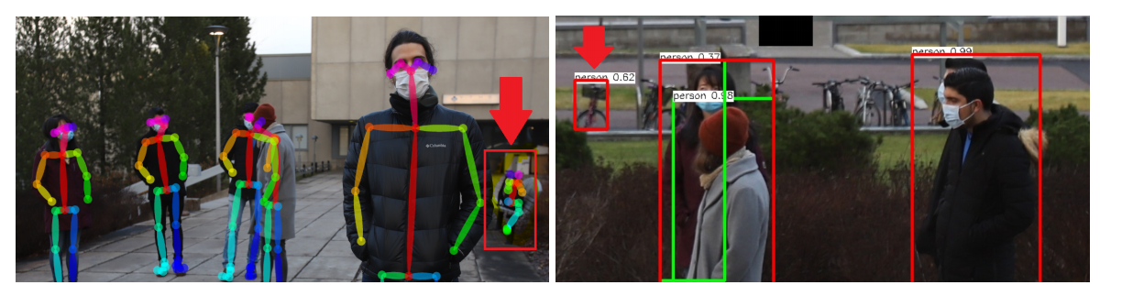
Image recognition and breach detection (2/2)
Adequate solutions
Perceiving Humans: from Monocular 3D Localization to Social Distancing
Automatic Social Distance Estimation From Images: Performance Evaluation, Test Benchmark, and Algorithm
The proposed method to estimate social distances takes
advantage of object detection and human pose estimation
methods.
Firstly, the input image is given to YOLOv4 object detection model to obtain bounding boxes for people.
After bounding boxes are obtained, overlapping boxes are
grouped together.
Then, these grouped boxes are cropped from the full image and they are individually given to OpenPose human pose estimation mode.
After the cropped images from YOLOv4 are processed
by the OpenPose model, the skeleton keypoints for detected
human bodies are extracted.
The middle points of each detected keypoint pair are used to represent a 3D location for the person.
Finally, the method computes the distances between all the pairs of detected people and gives them as outputs.
The goals of this method are:
to detect humans in 3D given a single image and
to leverage this information to recognize social interactions and monitor social distancing
It goes beyond monocular 3D localization of humans and detect social interactions (e.g., whether two people are talking to each other)
An image is used as input for the system.
We use a pose estimator to detect a set of keypoints for every instance in the image (Pose estimation refers to computer vision techniques that detect human figures in images and video)
Use the Monoloco++ algorithm which takes as inoput the set of 2D joints extracted from the raw image and outputs the 3D location, orientation and dimensions of the humans
All outputs are then analyzed to discover F-formations: spatial patterns formed during face-to-face interactions between two or more people

